Slide 1
CS112: Introduction to Python programming
Week 5: Data Type and Errors

Slide 2
Contents
Dictionary
Exceptions
Errors

Slide 3


Data collections
“data containers”
1. Lists （列表）
A sequence of objects (can be in different types; can have repetitions ), in a specific order; Lists can be modified
E.g.
2. Tuples （元组）
A sequence of objects in a specific order (like a list); but cannot be changed once created
E.g.
Notes:
list_a = [3.14,"Hello World",123,[1,2,3],'Hello World']
list_a
tuple_a = ("H20",18)
tuple_a

Slide 4
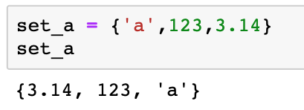
Data collections
“data containers”
3. Sets (集合)
A collection of objects (can be in different types, but cannot be repeated) in no particular order.
E.g.
Notes:
set_a = {'a',123,3.14}
set_a

Slide 5
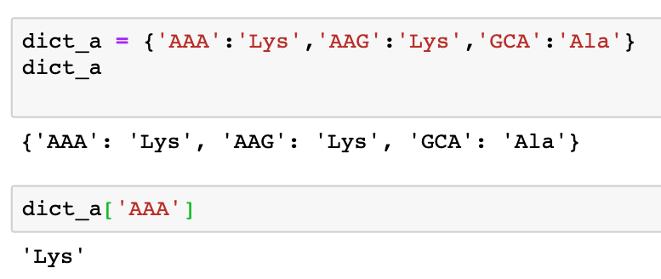
Data collections
“data containers”
4. Dictionaries （字典）
A look-up table to associate pairs of data objects (key : value)

Slide 6
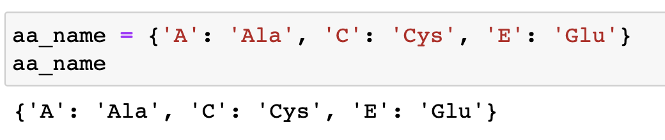
Dictionary
A dictionary is a look-up table to associate pairs of data objects (key（键） : value（值）); unordered
Create a dictionary using curly brackets {}:
{ key1 : value1, key2 : value2, key3 : value3 }

Slide 7
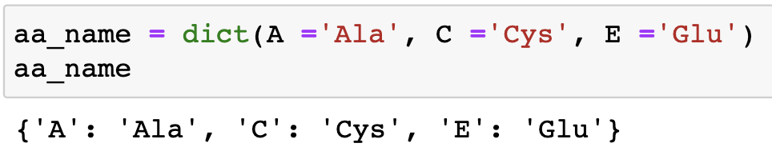
Dictionary
Create a dictionary
A dictionary can also be created from a sequence with dict :
Keyword arguments

Slide 8
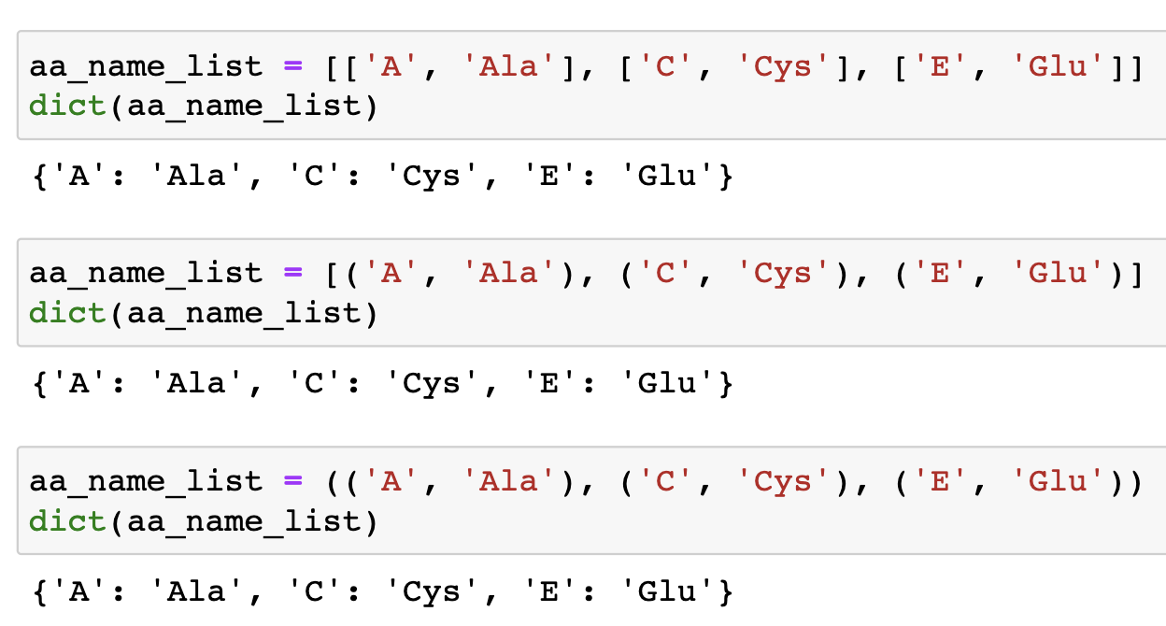
Dictionary
Create a dictionary
List/tuple of lists/tuples to dict :

Slide 9
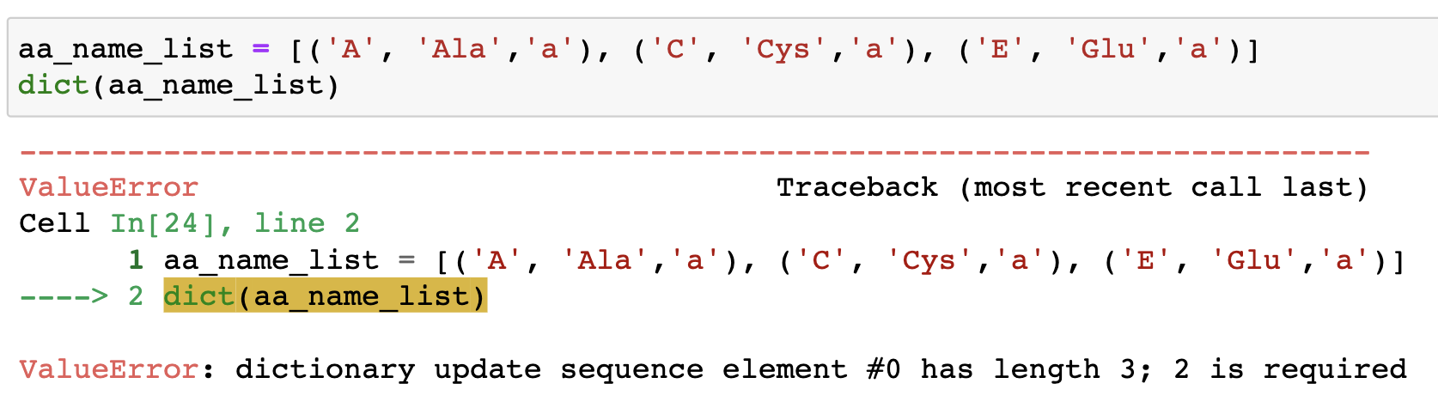
Dictionary
Create a dictionary
List/tuple of lists/tuples to dict :

Slide 10
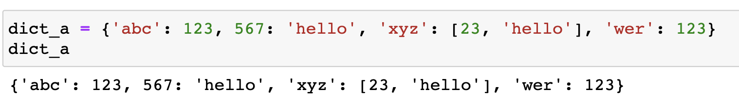
Dictionary
Keys（键）:
Only immutable objects like strings, tuples and numbers can be used as keys. If the tuple contains any mutable object, it cannot be used as a key. Lists can not be used as keys.
keys must be unique within a dictionary
Notes:
aa_name = { 'A':'Ala', 'C':'Cys','E':'Glu'}
aa_name.keys()

Slide 11
Dictionary
Values (值):
Values can be lists or tuples.
Values can be repeated
Notes:
aa_name = { 'A':'Ala', 'C':'Cys','E':'Glu'}
aa_name.keys()

Slide 12
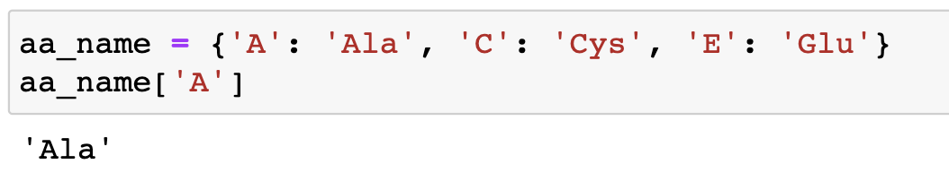
Dictionary indexing
Dictionaries are indexed by keys, and the entries can be accessed by keys:
dictionary_name[key]

Slide 13
Dictionary indexing
Dictionaries are indexed by keys, and the entries can be accessed by keys:
dictionary_name[key]
Slicing in dictionaries is not allowed since they are not ordered like lists

Slide 14
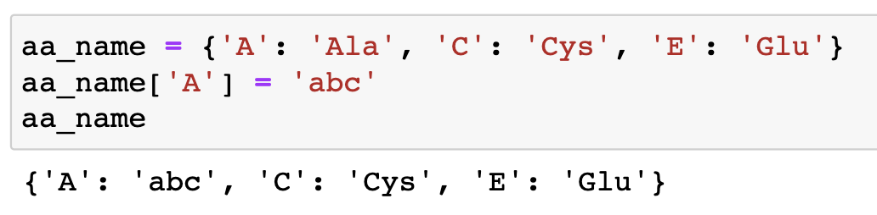
Dictionary operations
Adding / updating elements:
dictionary_name[key] = value
If the key is already in the dictionary, its value will be updated with the new value; if the key is not present, the new key:value pair will be added to the dictionary.

Slide 15
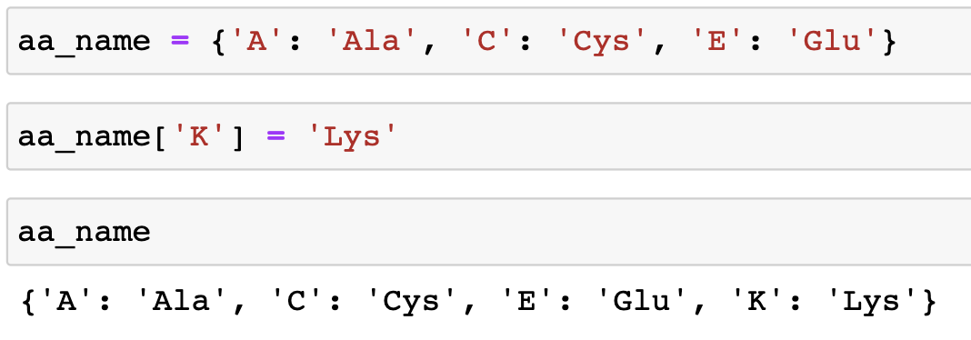
Dictionary operations
Adding / updating elements:
dictionary_name[key] = value
If the key is already in the dictionary, its value will be updated with the new value; if the key is not present, the new key:value pair will be added to the dictionary.

Slide 16
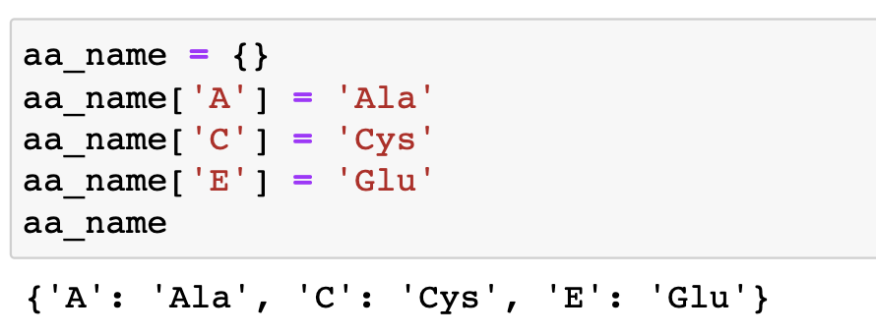
Dictionary operations
Dictionary can be created from an empty dictionary

Slide 17
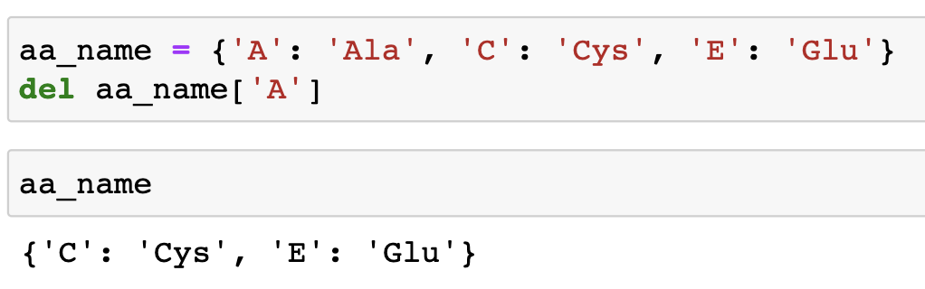
Dictionary operations
Removing elements: del
Notes:
aa_name = { 'A':'Ala', 'C':'Cys','E':'Glu'}
aa_name['K'] = 'Lys'
aa_name

Slide 18
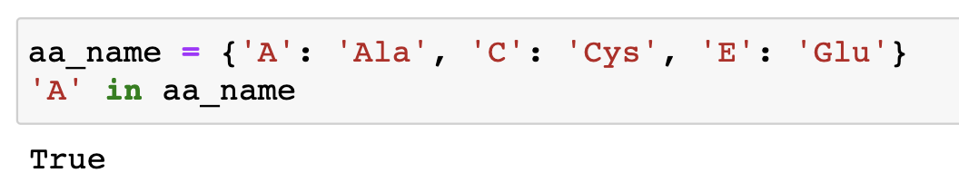
Dictionary operations
in and not in: check the presence of a key in the dictionary using membership operators
Notes:
aa_name = { 'A':'Ala', 'C':'Cys','E':'Glu'}
aa_name['K'] = 'Lys'
aa_name

Slide 19
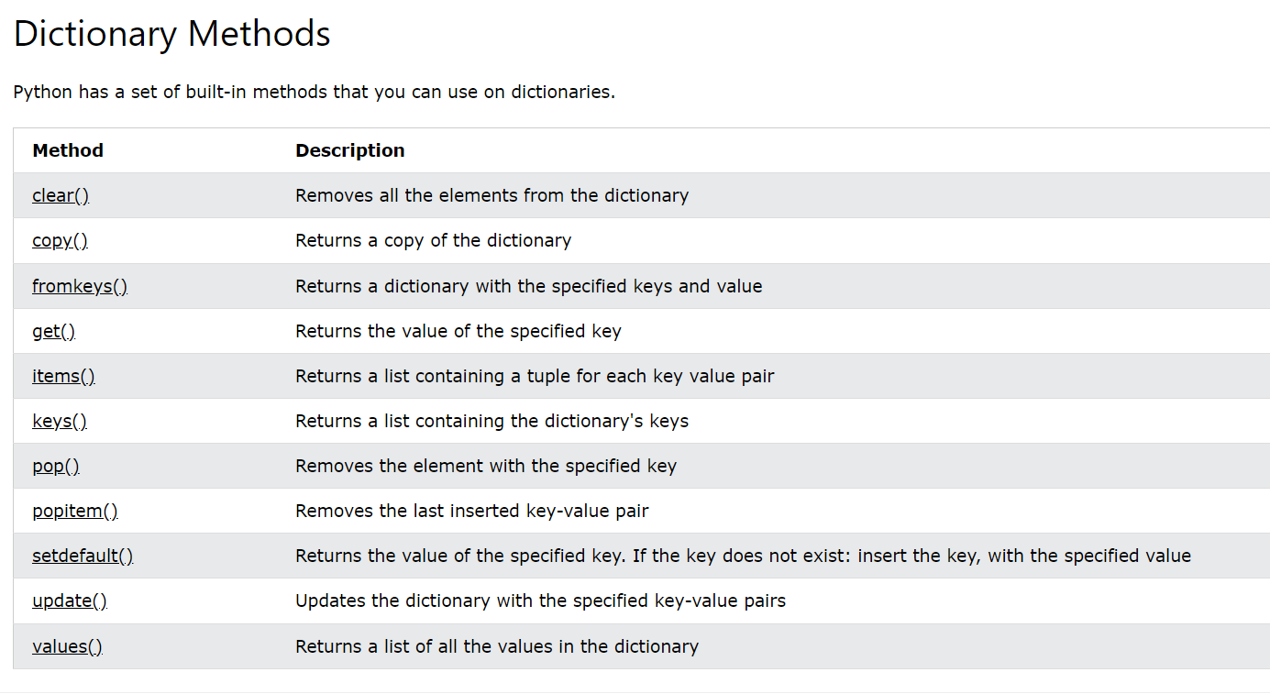
Dictionary methods
Notes:
aa_name = { 'A':'Ala', 'C':'Cys','E':'Glu'}
aa_name.keys()

Slide 20
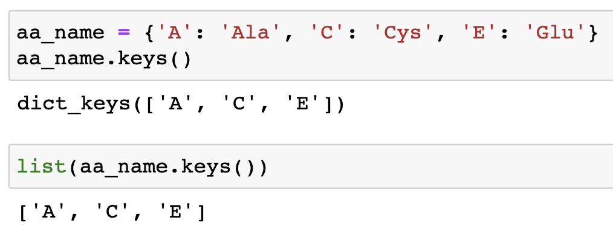
Dictionary methods
.keys(): Returns a list containing the dictionary's keys
.values(): Returns a list of all the values in the dictionary
.items(): Returns a list containing a tuple for each key value pair
Notes:
aa_name = { 'A':'Ala', 'C':'Cys','E':'Glu'}
aa_name.keys()

Slide 21
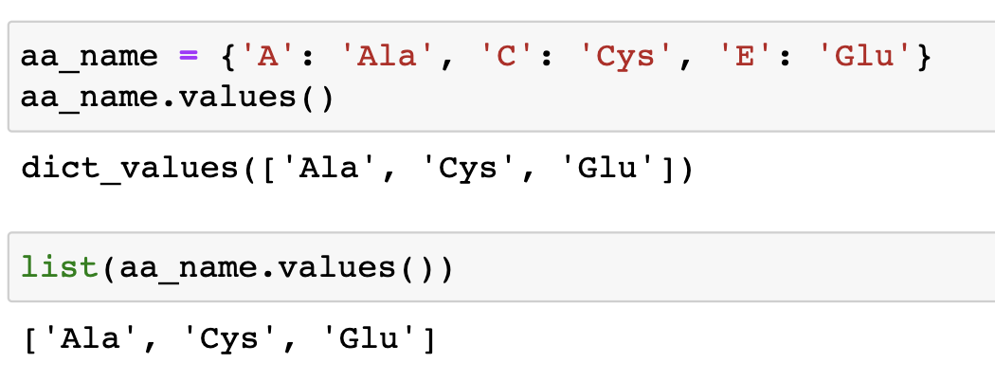
Dictionary methods
.keys(): Returns a list containing the dictionary's keys
.values(): Returns a list of all the values in the dictionary
.items(): Returns a list containing a tuple for each key value pair
Notes:
aa_name = { 'A':'Ala', 'C':'Cys','E':'Glu'}
aa_name.keys()

Slide 22
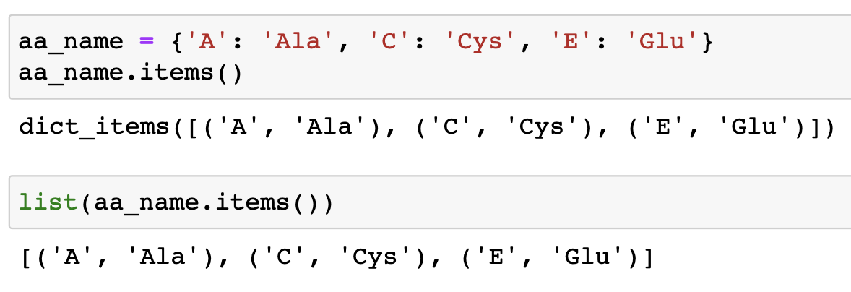
Dictionary methods
.keys(): Returns a list containing the dictionary's keys
.values(): Returns a list of all the values in the dictionary
.items(): Returns a list containing a tuple for each key value pair
Notes:
aa_name = { 'A':'Ala', 'C':'Cys','E':'Glu'}
aa_name.keys()

Slide 23
Dictionary methods
get(): returns the value of the item with the specified key.
dictionary.get(keyname, value)
Parameter | Description
keyname | Required. The keyname of the item you want to return the value from
value | Optional. A value to return if the specified key does not exist. Default value None
Notes:
aa_name = { 'A':'Ala', 'C':'Cys','E':'Glu'}
aa_name.keys()

Slide 24
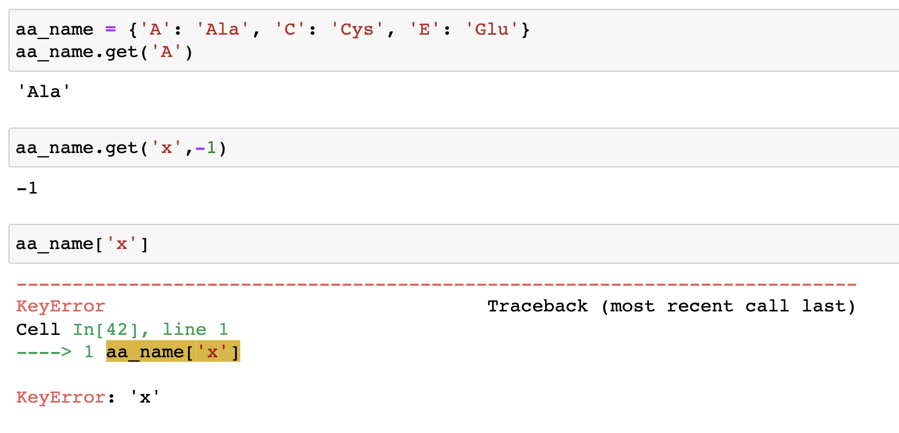
Dictionary methods
get(): returns the value of the item with the specified key.
dictionary.get(keyname, value)
Notes:
aa_name = { 'A':'Ala', 'C':'Cys','E':'Glu'}
aa_name.keys()

Slide 25
Dictionary methods
get(): returns the value of the item with the specified key.
dictionary.get(keyname, value)
Notes:
aa_name = { 'A':'Ala', 'C':'Cys','E':'Glu'}
aa_name.keys()

Slide 26
Dictionary methods
update(): Updates the dictionary with the specified key-value pairs.
dictionary.update(iterable)
Parameter | Description
iterable | A dictionary or an iterable object with key value pairs, that will be inserted to the dictionary
Notes:
aa_name = { 'A':'Ala', 'C':'Cys','E':'Glu'}
aa_name.keys()

Slide 27
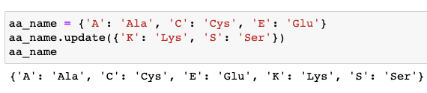
Dictionary methods
update(): Updates the dictionary with the specified key-value pairs.
dictionary.update(iterable)
Notes:
aa_name = { 'A':'Ala', 'C':'Cys','E':'Glu'}
aa_name.keys()

Slide 28
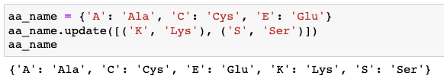
Dictionary methods
update(): Updates the dictionary with the specified key-value pairs.
dictionary.update(iterable)
Notes:
aa_name = { 'A':'Ala', 'C':'Cys','E':'Glu'}
aa_name.keys()

Slide 29
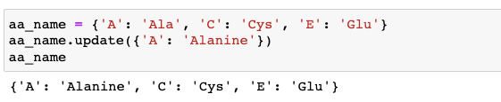
Dictionary methods
update(): Updates the dictionary with the specified key-value pairs.
dictionary.update(iterable)
Notes:
aa_name = { 'A':'Ala', 'C':'Cys','E':'Glu'}
aa_name.keys()

Slide 30
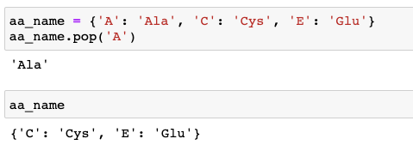
Dictionary methods
pop(): Removes the element with the specified key and returns its value.
Notes:
aa_name = { 'A':'Ala', 'C':'Cys','E':'Glu'}
aa_name.keys()

Slide 31
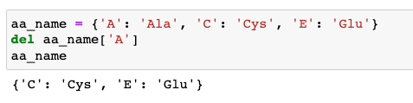
Dictionary methods
del : Removes the element with the specified key
Notes:
aa_name = { 'A':'Ala', 'C':'Cys','E':'Glu'}
aa_name.keys()

Slide 32
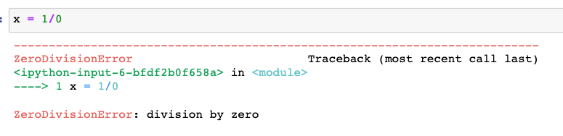
Error handling
A program rarely works as expected, at least on the first try.
Python deals with errors caused by illegal circumstances, which are called exceptions (异常)

Slide 33
exceptions
异常是程序执行中影响程序正常执行的一个异常事件
异常也是Python的对象，程序运行中需要捕获异常并进行处理，否则程序无法正常运行
异常处理可以使程序处理完异常后还可以继续执行

Slide 34
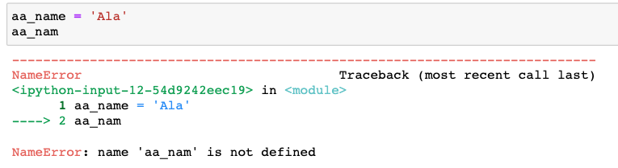
Error types
There are different types of errors.
E.g.
NameError type

Slide 35
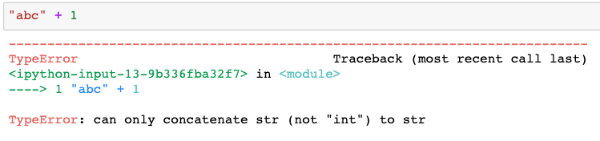
Error types
There are different types of errors.
E.g.
NameError type
TypeError type
Notes:
Raised when an operation or function is applied to an object of inappropriate type. The associated value is a string giving details about the type mismatch.

Slide 36
Error types
There are different types of errors.
E.g.
NameError type
TypeError type
…
some materials for Errors in Python
http://www.coolpython.net/python_primary/exection/common_error.html
https://www.datacamp.com/tutorial/exception-handling-python

Slide 37
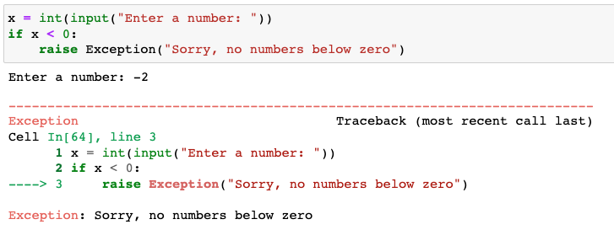
Raise exceptions
raise: To cause your own exception; doesn’t have to be an illegal Python state. You can define what kind of error to raise, and the text to print to the user.
Notes:
aa_of_interests = 'K'
aa_name = { 'A':'Ala', 'C':'Cys','E':'Glu'}
if aa_of_interests not in aa_name.keys():
raise Exception('The amino acid does not exist in the library!')

Slide 38
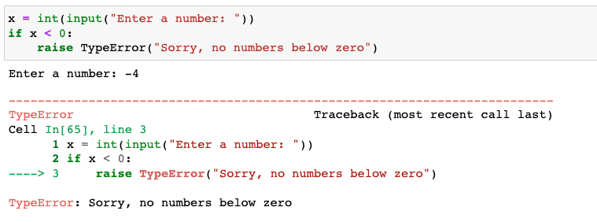
Raise exceptions
raise: To cause your own exception; doesn’t have to be an illegal Python state. You can define what kind of error to raise, and the text to print to the user.
Notes:
aa_of_interests = 'K'
aa_name = { 'A':'Ala', 'C':'Cys','E':'Glu'}
if aa_of_interests not in aa_name.keys():
raise Exception('The amino acid does not exist in the library!')

Slide 39
Catching exceptions
Rather than simply letting such things break the program, Python allows you to ‘try’ something and then ’catch’ the exceptions that might occur and do something about it, and potentially let the program carry on afterwards.
try/except 用来检验try语句块中的异常，然后用except语句来捕获异常信息并处理。

Slide 40
Catching exceptions
Try and Except
try:
# ...some error prone code...
code block 1
except:
# ...do something with the error...
code block 2
else:
# ...to do when there is no error...
code block 3
finally:
#...some clean up code...
code block 4
A try block consisting of one or more statements that might be affected by an exception
The except blocks are used to handle any resulting exceptions thrown in the try block
An else or finally statement is optional
A finally block is always executed, no matter an exception has occurred or not

Slide 41
Catching exceptions
Try and Except
try:
# ...some error prone code...
code block 1
except Exception_Name_1:
# ...do something with the error...
code block 2
else:
# ...to do when there is no error...
code block 3
finally:
#...some clean up code...
code block 4
The except statement can be specified for different types of exceptions.
Only one except block is executed for each exception that is thrown

Slide 42
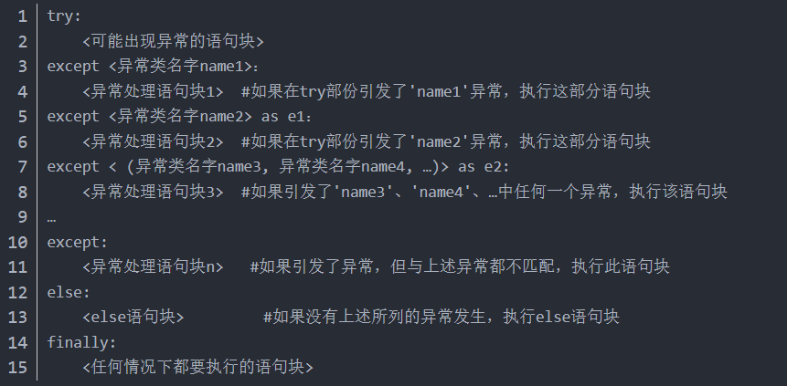
try/except

Slide 43
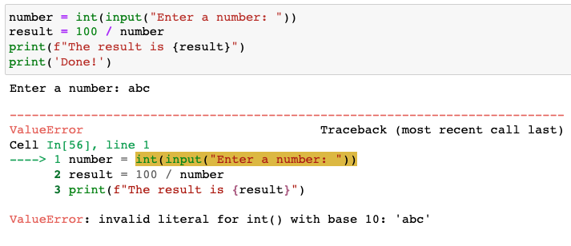
Catching exceptions
Try and Except

Slide 44
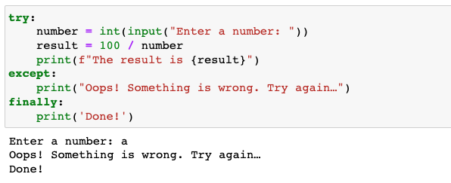
Catching exceptions
Try and Except

Slide 45
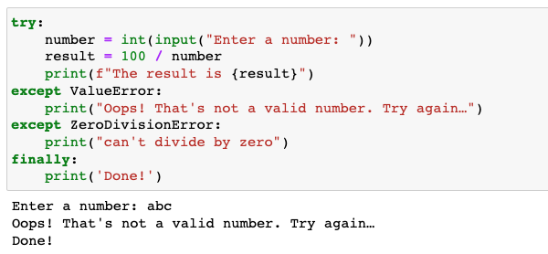
Catching exceptions
Try and Except

Slide 46
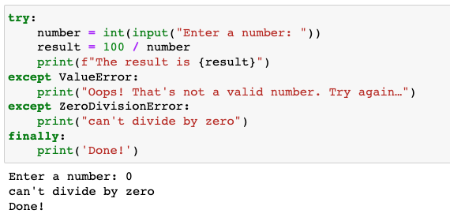
Catching exceptions
Try and Except

Slide 47
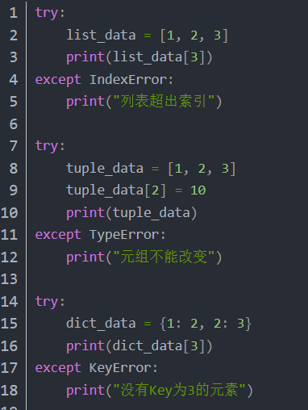
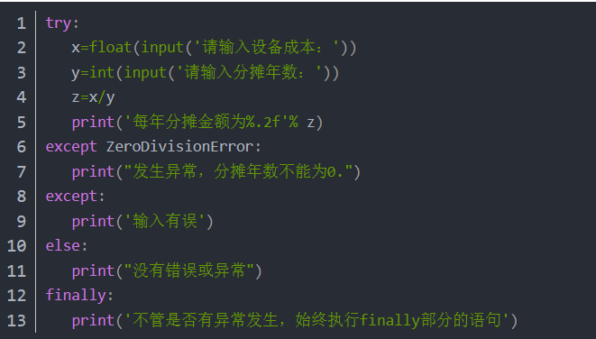
example

Slide 48
Raise exceptions
raise: To cause your own exception; doesn’t have to be an illegal Python state. You can define what kind of error to raise, and the text to print to the user.
Notes:
aa_of_interests = 'K'
aa_name = { 'A':'Ala', 'C':'Cys','E':'Glu'}
if aa_of_interests not in aa_name.keys():
raise Exception('The amino acid does not exist in the library!')

Slide 49
Raise exceptions
raise: To cause your own exception; doesn’t have to be an illegal Python state. You can define what kind of error to raise, and the text to print to the user.
Notes:
aa_of_interests = 'K'
aa_name = { 'A':'Ala', 'C':'Cys','E':'Glu'}
if aa_of_interests not in aa_name.keys():
raise Exception('The amino acid does not exist in the library!')

Slide 50
raise example
s = None
if s is None:
print "s 是空对象"
raise NameError #如果引发NameError异常，后面的代码将不能执行
print len(s) #这句不会执行，但是后面的except还是会走到
except TypeError:
print "空对象没有长度"

Slide 51
raise example
s = None
if s is None:
raise NameError
print 'is here?' #如果不使用try......except这种形式，那么直接抛出异常，不会执行到这里

Slide 52
练习
https://pynative.com/python-dictionary-quiz/

